Slide 1
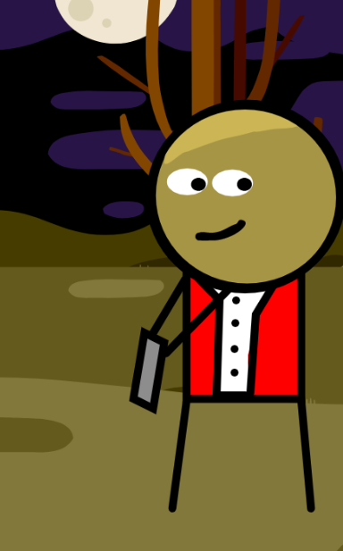
Dive into Zombie Rush!
"Zombie Rush" is a thrilling two-player game where you fight off hordes of zombies. Outscore your friend by shooting zombies and collecting bonuses.

Slide 2
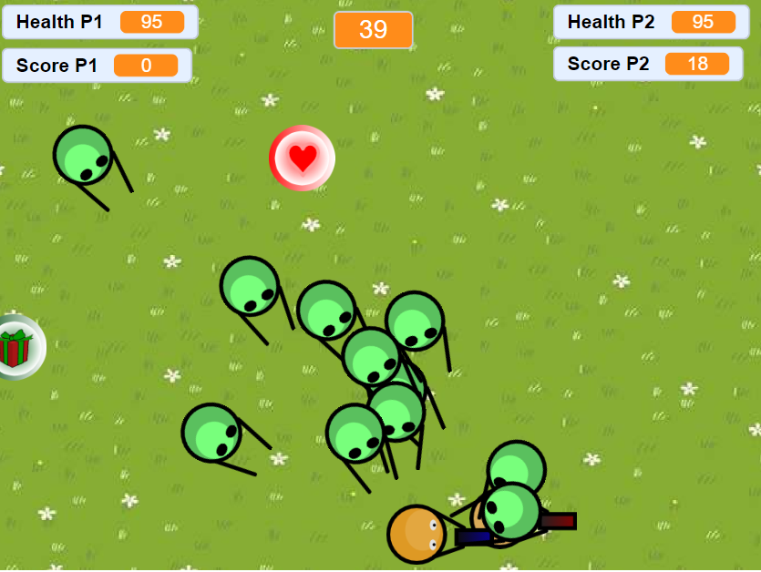
Objectives
1
Outscore Your Opponent
Earn points by shooting down zombies and collecting bonuses.
2
Survival is Key
Dodge incoming zombies and manage your health to stay alive.
3
Strategic Gameplay
Aim for precision shooting and utilize bonuses strategically to maximize your score.

Slide 3
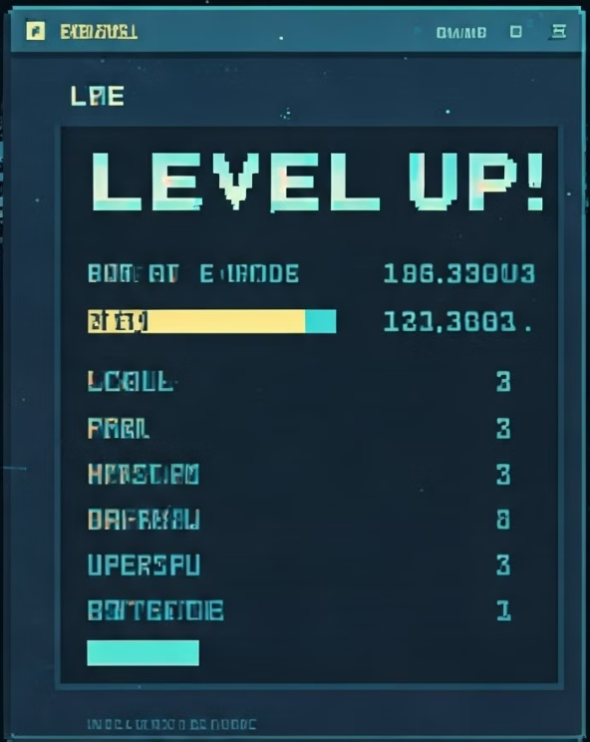


Levels and Challenges
1
Level 1
Starting level with moderate zombie speed and frequency. When timer hits zero, the level switches to the next one.
2
Level 2
Increased zombie speed and frequency, posing a greater challenge.
3
Level 3
Timer:
The most challenging level with the fastest and most frequent zombie attacks.

Slide 4

Game Components
Backdrops
Sprites
Sounds
Start Menu, Ground background (top-down view), Instructions backdrops.
Player, Zombie, Bullets, Bonuses (Health, Bullet increase, Gifts), Level sprites, Buttons (Start, Back, Retry, Instructions), Winner sprites, Draw Sprite.
Engaging background music, zombie killing effects, ending sounds, bonus collection sounds.

Slide 5
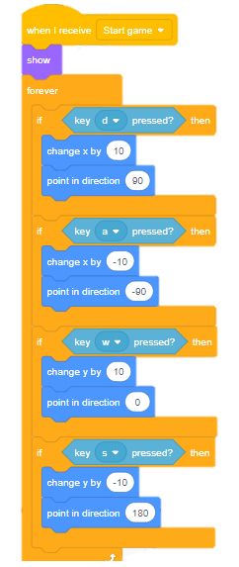
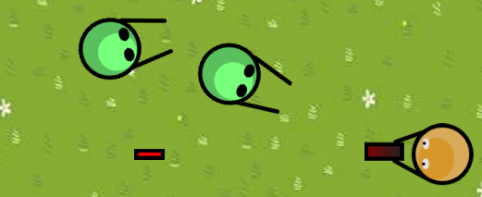

W
A
S
D
Controls and Scoring
Player 1
Use 'a', 's', 'd', 'w' keys to move, 'space' to shoot.
Player 2
Use arrow keys to move, 'm' key to shoot.
Scoring
Kill zombies and collect gift bonuses to earn points.

Slide 6




Bonus Features
Health Restore
Gift Bonuses
Bullet Frequency Increase
Collect heart bonuses to replenish your health and survive longer.
These bonuses award random score points, adding an element of surprise.
Power up your shooting rate to take down zombies more efficiently.

Slide 7
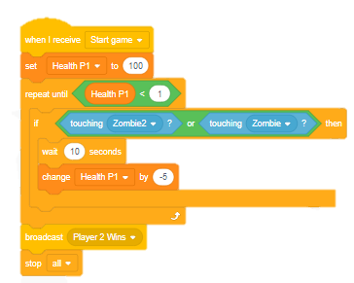




Lifeline and End Game
Health
Your health depletes upon contact with zombies. Collect heart bonuses to restore it.
Game Over
The game ends if a player's health reaches zero or after completing three levels.
Victory
The player with the highest score at the end wins!

Slide 8
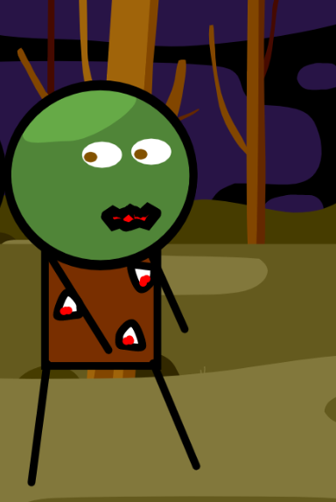
Get Ready to Survive!
"Zombie Rush" provides a thrilling and dynamic multiplayer experience. With its multiple levels, engaging bonuses, and strategic gameplay, it offers an immersive and memorable gaming experience. Prepare to test your zombie-slaying skills and emerge victorious!

Slide 9
Thank You So Much
Submitted By::
Umair Arshad 2024-SE-38
Sagheer Ashar 2024-SE-48
Nabeel Tahir 2024-SE-47
Submitted To:
:Ms. Rimsha Noreen
Ms. Rida Saeed

